Slide 1
Licencing of EMEP observation data Analysis of 2020-21 Lockdown based on EMEP data
Kjetil Tørseth, NILU/EMEP-CCC

Slide 2
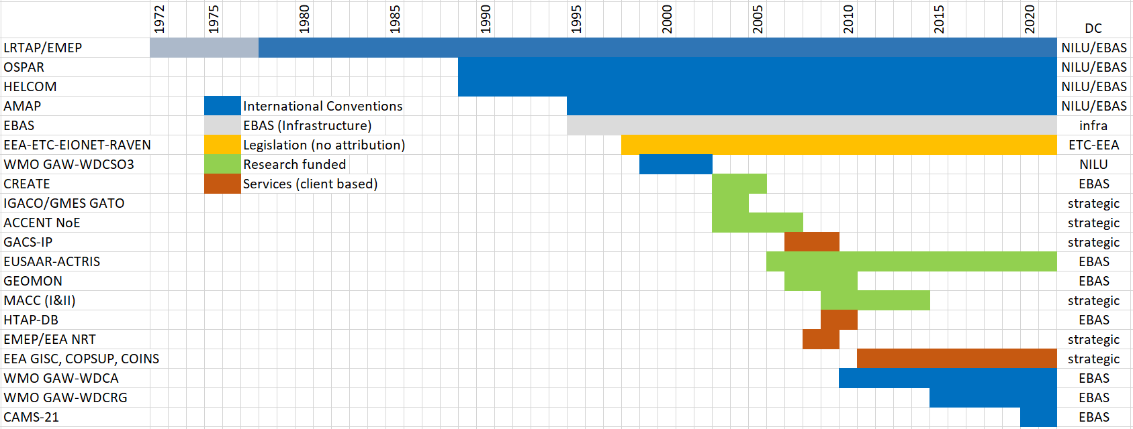
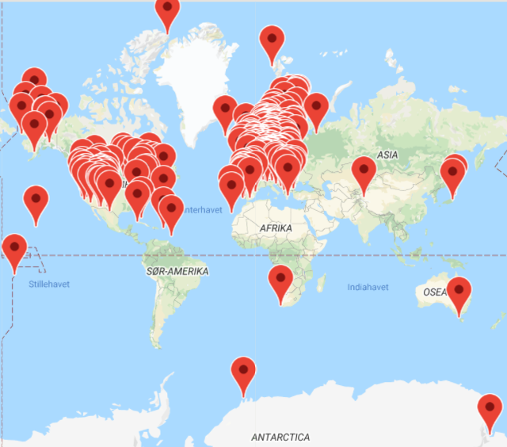
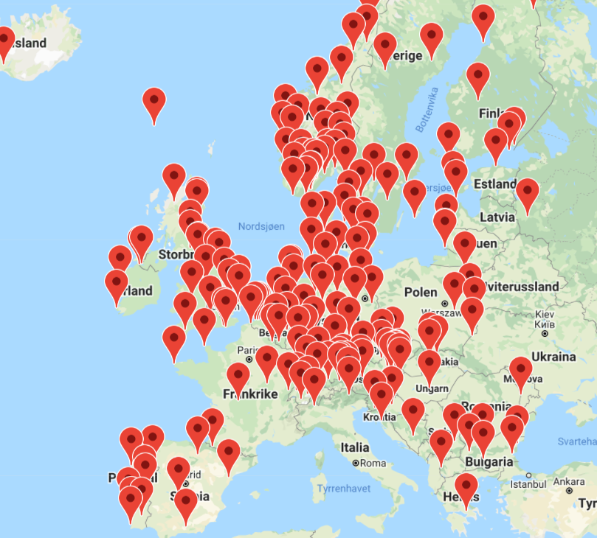
European background stations (EMEP/EBAS++) data management
1990

Slide 3
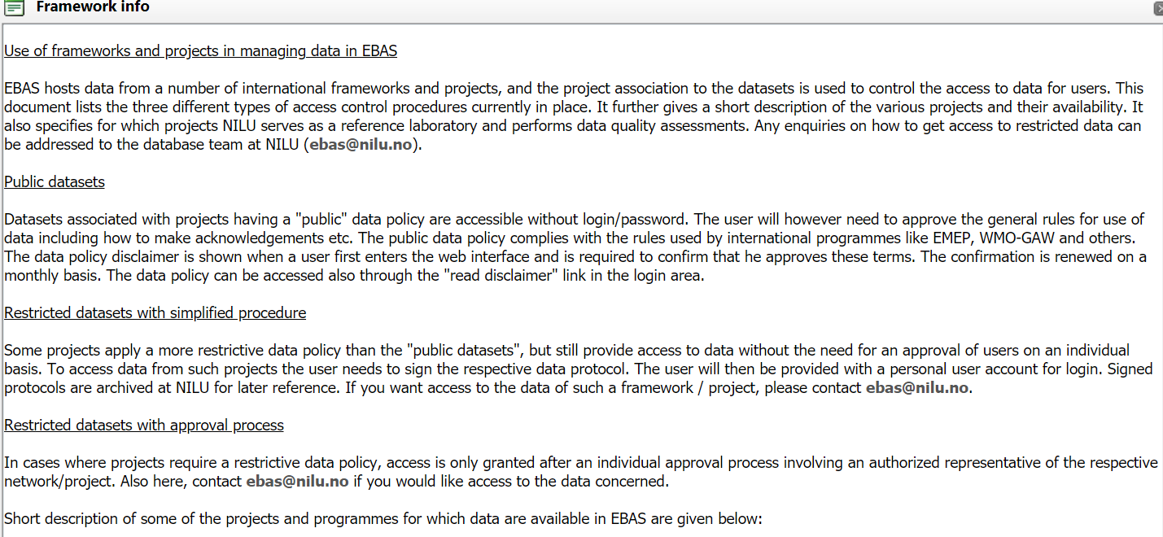
http://ebas.nilu.no

Slide 4
«Frameworks» in EBAS
Framework indicates which project, program or organisation a dataset is affiliated («belong») to
Reflects the formal justification for observations to have been made (funding/obligation)
Basis for informing about data policies and acknowledgements
Label reflecting how measurements are made and have been quality assured
E.g datasets affiliated to EMEP are goverened by EMEP principles, governance structure, AQAC approaches, etc.
Also used to limit access to non-public, restricted datasets or datasets with special «caveats»
EMEP, EMEP_NRT, EMEP_preliminary
_legacy, _public, _internal
A dataset may be affiliated to several Frameworks

Slide 5
EMEP data are
Governmental public data delivered by agencies (many regulations in place to secure open access to public data (Aarhus Convention, Open data Directive, ++)
Data with IPR issues due to their provision by researchers and research organisations
The major fraction of EMEP observations are type II (and the general rules for data management are in compliance with such needs)
Very rare (!) have data misused in relation to the IPR-interests of the data providers
EMEP - «open access» since 1977!

Slide 6
«Substantial use»
A term widely used to indicate that data are openly available, but there is an expectation that if data are analysed in detail for the purpose of a report or publication with scientific merit, that the data originators are consulted and offered a co-authorship
(vague definition, but very few examples of DOs expressing that their rights have been violated).

Slide 7
«Data and services»
The current thinking is that through «open data access» both research capabilibites and the economy shall grow substantially. Governments need to show that they comply with ODD and national legislation. Programs need to demonstrate their importance for society, UN SDGs.
->The Framework/data host perspective:
Large efforts used to manage data (5-10 persons for 4+ decades, with large institutional investement
Bulk download of EMEP data takes a few hours,
deliver an additional service,
service contract with users
poor or no acknowledgement of the underlying resources comitted
->The researcher perspective:
Data are used without serving the interests of the one holding IPR rights
European Open Science Cloud, FAIR-principles +++ Research Data Aliance,

Slide 8
Basics: Immateral rights – Intellectual property rights
Intellectual work protected if:
Scientific, literature or artistic work (not public documents)
Original and creative, and by own efforts
IPR is related to the expression itself, not the «idea»
Ideal rights: right to be acknowledged and not be «violated by the use..»
Economic rights: related to reproduction, distribution, display, transformation
The holder of IPR-rights may use a licence to allow use and re-use

Slide 9
Suggested approach for EBAS and the framworks with public/open data policy
Introduce licences to secure IPR rights
PID/DOIs to allow better tracking the actual use of datasets
Development of a licencing arrangement to secure the rights of
frameworks,
the database provider
the data originators

Slide 10
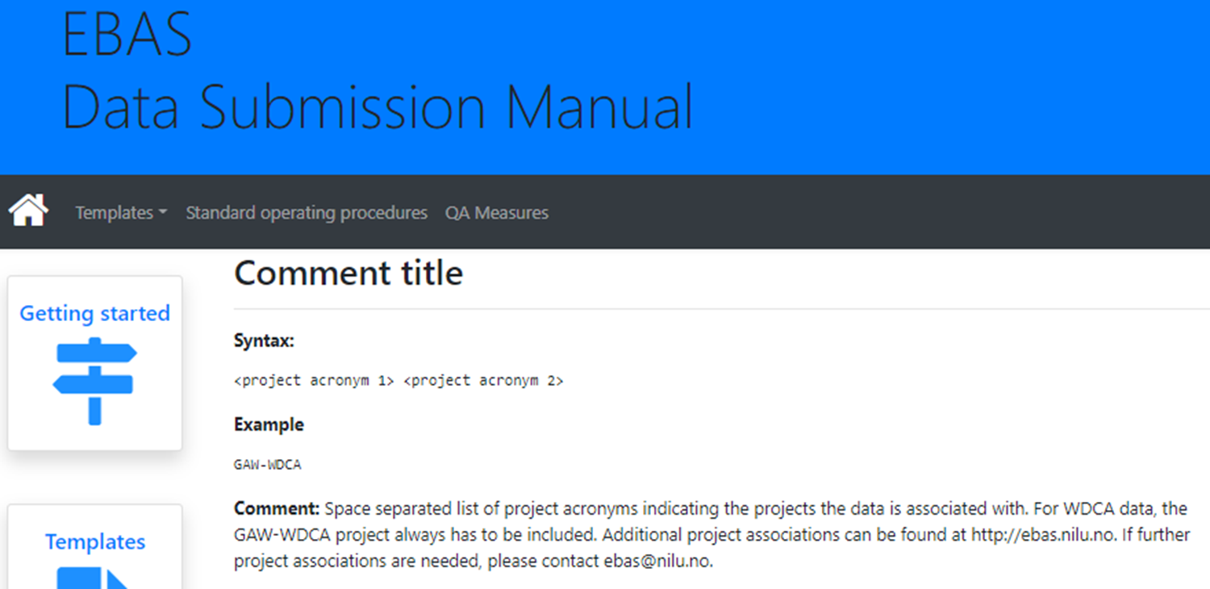
1. «Framework rights»
Objective: Secure that attribution is given to all frameworks a given dataset is affiliated to

Slide 11
2. Database rights
A database right is a sui generis property right, comparable to but distinct from copyright, that exists to recognise the investment that is made in compiling a database, even when this does not involve the "creative" aspect that is reflected by copyright.^{[1]} Such rights are often referred to in the plural: database rights.
Objective: Secure that users gives credit to the holder of rights to the database

Slide 12
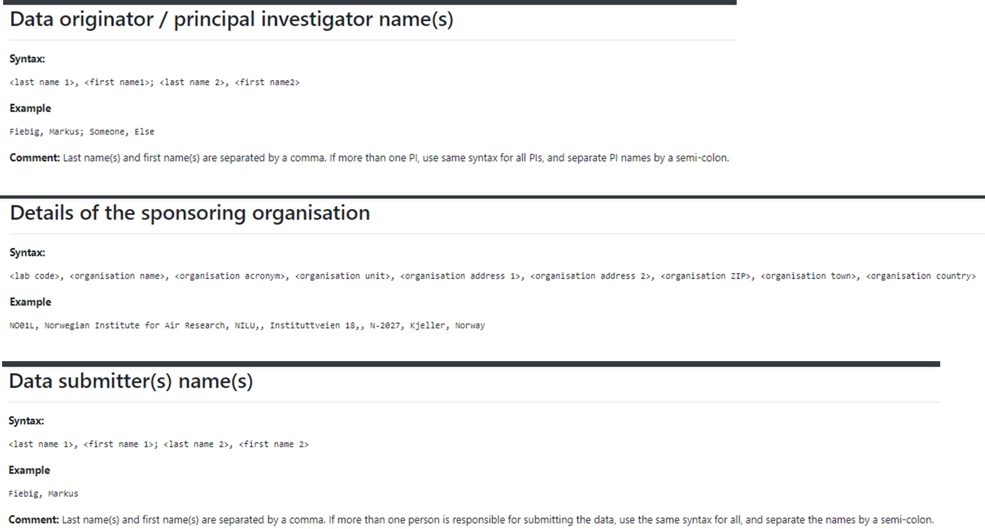
3. «Data originator rights»
Objective: To ensure that data made available through EBAS serves the IPR insterest of the scientific staff and institutions producing the data

Slide 13
EBAS Data Licence
Draft 0.2
EBAS data is licensed under the Creative Commons Attribution 4.0 International license (CC BY 4.0). The summary of (and not a substitute for) the licence can be found here: https://creativecommons.org/licenses/by/4.0/legalcode
For data associated with «Frameworks having a public data policy» (reference XXX), you are free to:
Share — copy and redistribute the material in any medium or format
Adapt — remix, transform, and build upon the material for any purpose, even commercially
Under the following terms:
Attribution — You must give appropriate credit to EBAS@NILU and the individual Frameworks to which datasets are associated. Use constraints: a recommendation, non-legally binding, to attribute in the case of substantial use; the individual data originators and the institutions producing the data (substantial use is generally defined as and in-dept analysis of specific datasets as a basis for scientific publications). You must also provide a link to the licence, and indicate if changes were made. You may do so in any reasonable manner, but not in any way that suggests the licensor endorses you or your use.
No additional restrictions — You may not apply legal terms or technological measures that legally restrict others from doing anything the license permits. The licensor cannot revoke these freedoms as long as you follow the license terms.
For data associated with «frameworks with a restricted data policy» (reference xxx), special conditions apply, and is not covered by this public data licence

Slide 14
Why not attribution to data originators
We believe it would make it close to impossible to make use data and results for the purpose of the Frameworks
DOs does not expect to have attribution unless in cases with «substatial use»
IPRs rights may also be questionable in some cases

Slide 15
Conclusion of data licencing
The suggested text is a preliminary to explore the community reactions and to solicit feedback
Needs to be formalized in consultance with IPR legal experts
Need a set of examples of acknowledgements to guide users

Slide 16
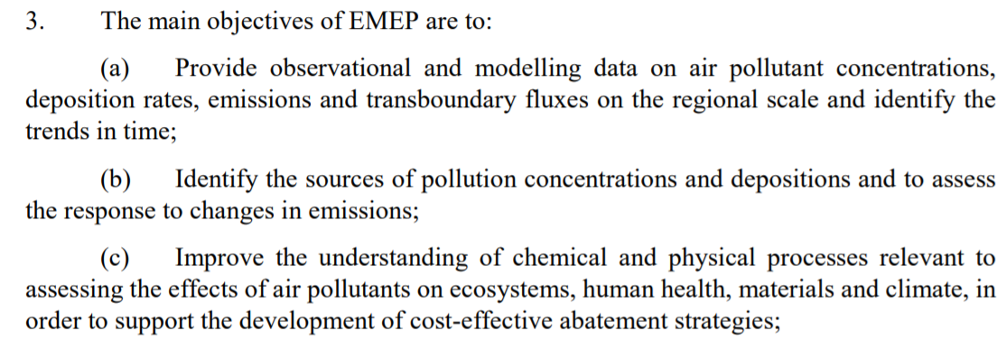
Covid-19 impacts

Slide 17
Rationale
A number of scientific studies (partly based on EMEP data) related to Covid-19 available or in progress
Most studies are based on automated methods, and presents the immediate impacts
EMEP is specially designed to monitor long-term trends and the linkages between emissions and exposure for the development of emission reduction protocols
It will be important (for several reasons) that EMEP demonstrates its capabilities to give insight into the impacts of Covid-19
EMEP will needs to assess the Covid-19 impacts on the achievements with respect to CLRTAP Protocols
Unique opportunity to study the understanding of processes

Slide 18
Suggested approach
EMEP Reports to present results and comment on the impacts of Covid-19
2020 data will become available summer 2021, but likely a community based assessment should include also data for year 2021.
Scope of an EMEP Covid-19 assessment can be initiated in 2021, but not finalized before fall 2022.
Level of ambition to be agreed (TFMM only or also TFEIP, WGE…?)
Important to engage EMEP national experts (not just another scientific paper)
Target audience: CLRTAP bodies and EMEP stakeholders

